Slide 1
Data Visualization
The Fundamentals of Excel Charts = Graphs

Slide 2

Art Skills Not Required

Slide 3
2 Main Types of Charts
Regular Charts
Usually more static. Interactivity based on formulas, drop-downs, etc.
Used for more advanced or complex charts.
Pivot Charts
Connected to a pivot table.
Can be limited on options and formatting.
Based on a range of cells.
More interactive. Easier to create and use for dashboards (slicers).

Slide 4
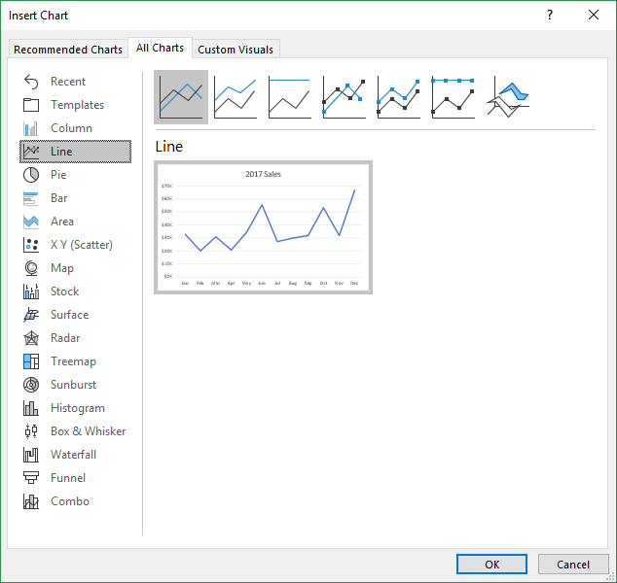
Chart Types

Slide 5






Basic Guide to Chart Types
Column/Bar: Categorical, time series, comparisons (actual vs budget)
Line: Time series trends (revenue/expense trend by month)
Histogram: Frequency distribution, numerical grouping of data (people in each age group, revenue by amount)
XY Scatter: Relationship between two metrics/variables (wait time vs customer satisfaction)
Waterfall: Categorized changes between two time periods (sales pipeline, inventory changes)
Pie: Percentage of whole, usually 4 or less categories.

Slide 6
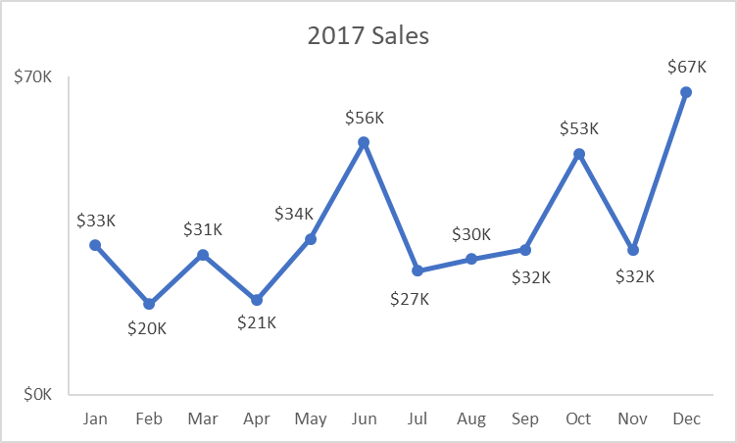
Data Visualization Basics
The goal of the visualization (chart) is to tell a story about the data.
Less is More. Remove chart junk (unnecessary elements).
Make it easy for the viewer to see trends, anomalies, etc.
Viewer should be able to quickly read & understand the visualization.

Slide 7
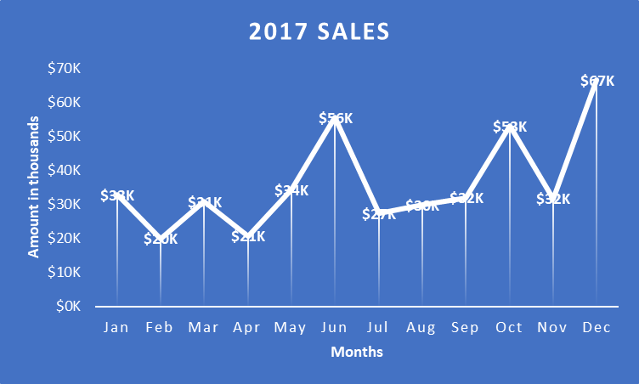
Good vs. Bad

Slide 8
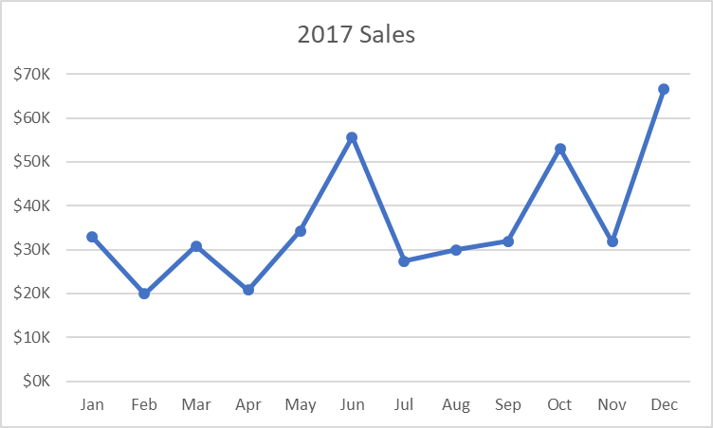
Good Examples
Minimal use of color.
Easy to read.
Minimal elements (titles, axes, gridlines, etc.)

Slide 9
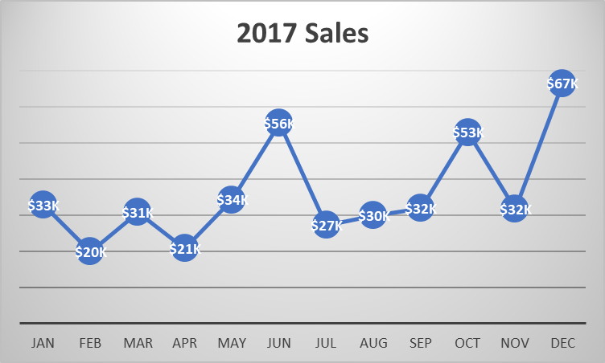
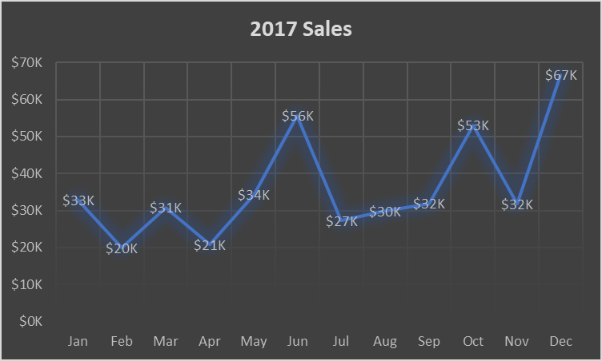
Bad Examples
Too many elements.
Difficult to read.
Chart junk distracts the reader.

Slide 10

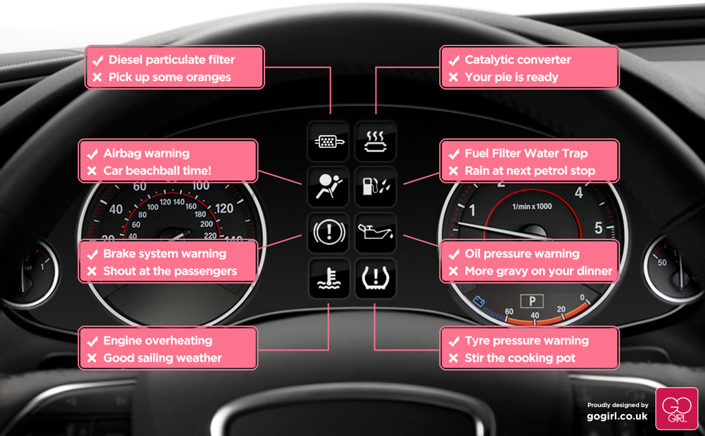
Does it Need Instructions?

Slide 11
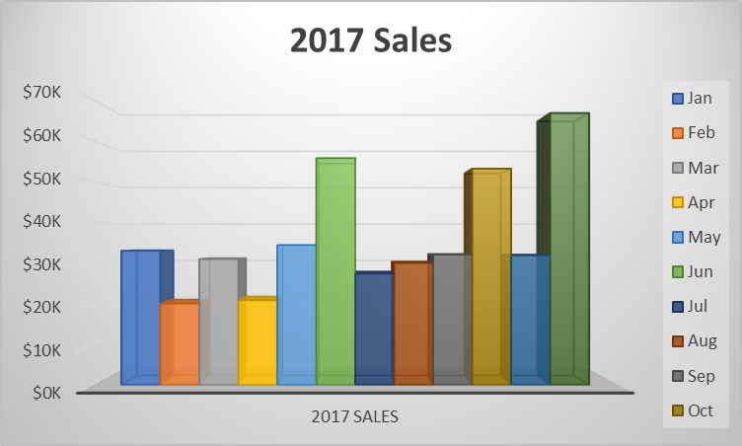
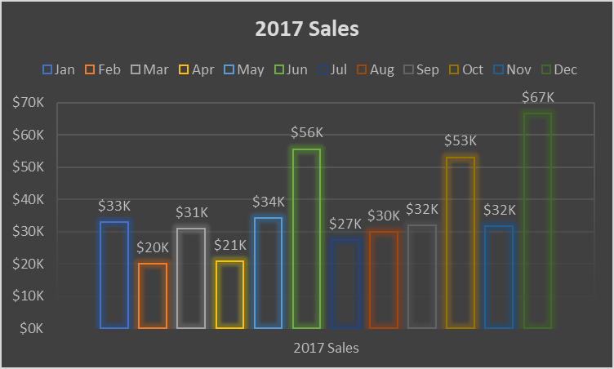

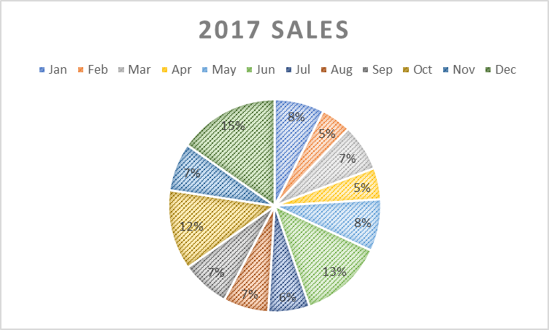
Road Test
Easy to read!

Slide 12
Stick with the basics
Pick the right visualization for the data.
Remove most default elements.
Only add back what’s necessary.
Let the data tell the story.

Slide 13
Don’t go Overboard
Don’t worry, it’s not your fault!
Entire books have been written on data visualization (theory).
Sometimes it just comes down to what the boss wants.
Error on the side of simple. You can always add more if needed.

